Slide 1
Welcome
Paula Hunter, Executive Director, Mojaloop Foundation
Rwanda, March 7, 2023

Slide 2
Meet our Team
Simeon Oriko, Director of Community
Steve Haley, Market Development and Partnerships
Desire Kachenje, Manager of Grants and Partnerships
Paul Makin, Product Management
Megan Cannon, Community Operations

Slide 3
Our Top Priorities
Deployment Successes
Product Alignment to Market Requirements
Continued Growth in our Community

Slide 4
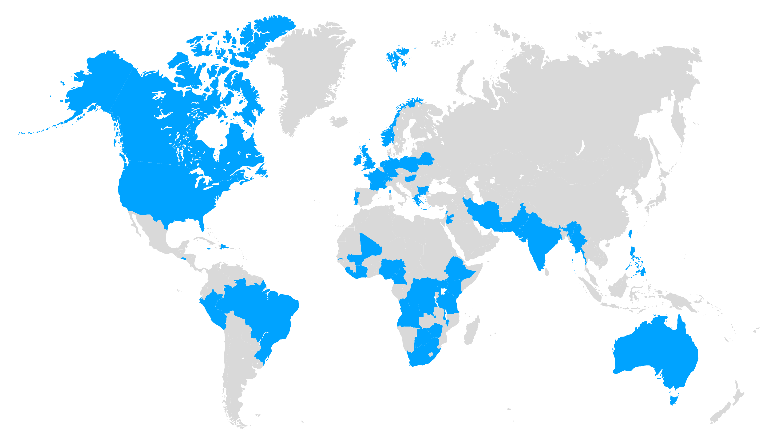
Many Thanks to Mojaloop Community – Thank You!
600+
6
47
Active participants and growing!
Continents
Countries
Notes:
The Mojaloop Foundation, with the funding and support of our sponsors will continue to advance the features and capabilities of the platform and support the community committed to our mission.

Slide 5
Product Focus
Steve Haley
Market Development and Partnerships
Mojaloop Foundation

Slide 6
Mojaloop Is Open Source Software For Instant Payments Clearing
Built specifically to help Hub Operators drive financial inclusion
and developed “ground up” with mobile payments enablement at its core, .
Mobile Financial Inst.
Mojaloop
Mobile Money Operators
Banks
Credit Unions
Central Bank
1. Local ownership and optionality
2. Lower cost for low value transactions
3. Lower cost and risk for different classes of DFSPs
4. Integrated support for the local fintech community
Telecom Providers
Notes:
Mojaloop was designed “ground up” specifically to deliver to financial services ecosystems the software for an instant payments clearing system and API protocol that helps Banks, MFIs, Saccos, Mobile Money companies all connect to the same payments rails
The API protocol does more than just move money: the design helps network participants to interact robustly with each other, and is important in helping bring some financial inclusion principles to life.
The protocol has 3 steps – DISCOVERY – AGREEMENT – TRANSFER - which I want to briefly unpack.
Steve:
Helps [lower the cost] for hub operators connect banks and non-banks of all shapes and sizes, without exposing their larger participants to any additional risks

Slide 7
Market Requirements
Make Adoption Easier
Achieve Scale
Connect to other systems

Slide 8
Market Requirements
Make Adoption Easier
Focused Messaging
Adoption Toolkit
Infrastructure
Portals
Achieve Scale
Connect to other systems

Slide 9
Market Requirements
Make Adoption Easier
Merchant Payments
3PPI
Achieve Scale
Connect to other systems

Slide 10
Market Requirements
Make Adoption Easier
Cross Border
DPG interoperability
Modularity of adjacencies
Achieve Scale
Work with other systems
Notes:
Mojaloop is not going to be adopted by every country in the world and it only solves one issue for national infrastructure. We are part of a larger ecosystem that serves humans in the last mile.
Unfortunately Mojaloop is special – it makes it a more efficient system at scale – but as we’ve already discussed – that makes it difficult.
To look at how this has already started working – please look at the partnerships and relationships we’ve developed around Cross border – Visa, BIS, Ant, RedCompass, MAS, NPCI – not to mention the CBDC center of excellence which is focused on Cross border.
With DPG interoperability, we’ve got two programs – G2P Connect and the Digital Convergence initiative.

Slide 11
Market Requirements
Make Adoption Easier
Achieve Scale
Connect to other systems

Slide 12
Priority Pillars
Make Adoption Easier
Achieve Scale
Connect to other systems
Quality Product

Slide 13
Have a great week!
phunter@mojaloop.io

